Slide 1
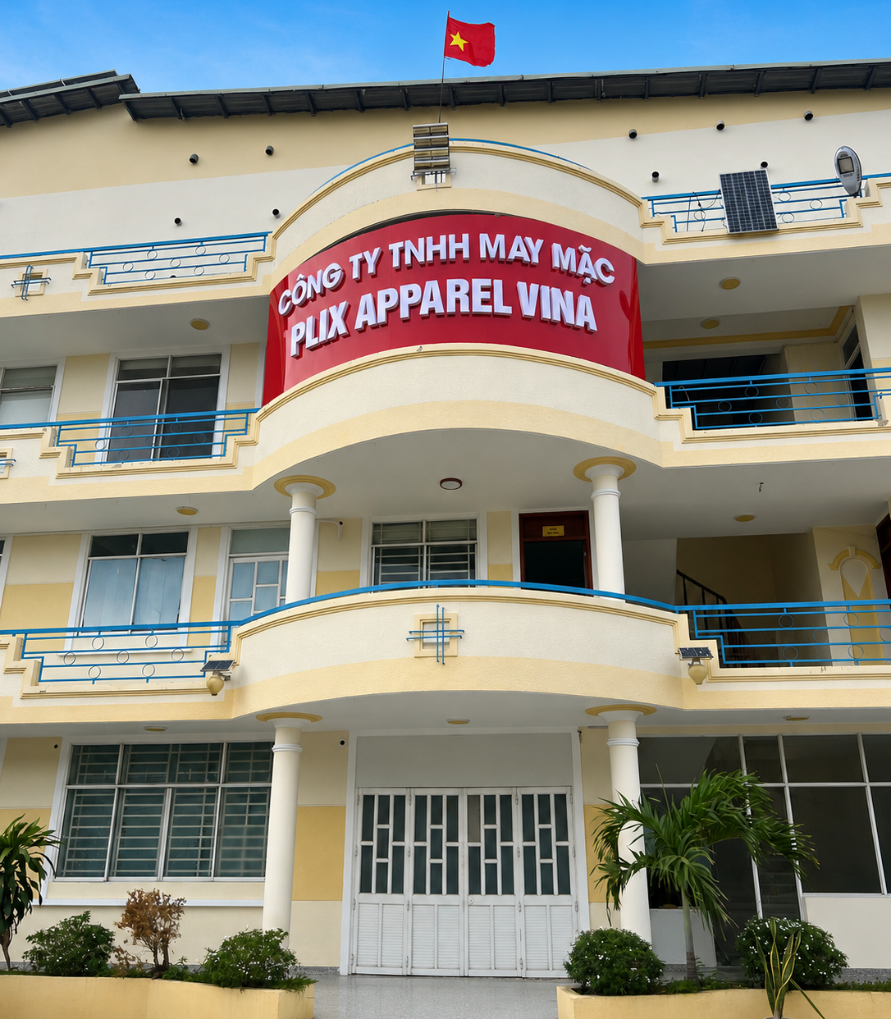
EXPANDED FACTORY PROFILE 2026
Plix Apparel Vina
Garment Co., Ltd.
Six sewing lines. 250–300 people.
A stronger Vietnam base for knit and woven programs.
HO CHI MINH CITY, VIETNAM • UPDATED 03 SEP 2026
Notes:
[Sources]
- User-provided 2026_PrixApparel_version02.pptx
- User-provided PLIX VINA PROFILE 2026.pptx
- User-provided exterior factory photograph, retouched at the user's request

Slide 2
CURRENT FOOTPRINT
Expanded capacity, built for growth
The relocated factory adds production depth while keeping development, quality, and execution close to the line.
6
250–300
Knit +
Woven
2,500
SEWING LINES
PEOPLE
PRODUCT CAPABILITY
M² LAND SIZE
Flexible line allocation by style, construction, and order mix.
A scaled workforce across production, quality, and support functions.
Experience across fashion, casual, kids, and outerwear categories.
Expanded site supporting production, quality, development, and logistics functions.
REGIONAL OPERATING MODEL
KOREA • Client & R&D
CHINA • Material sourcing
VIETNAM • Manufacturing & shipment
PLIX APPAREL VINA • FACTORY PROFILE 2026
02
Notes:
[Sources]
- User-provided 2026_PrixApparel_version02.pptx
- User-provided PLIX VINA PROFILE 2026.pptx
- Current scale and 2,500 m² land-size figures supplied directly by the user; regional operating model consolidated from the source profiles

Slide 3
DEVELOPMENT TO SHIPMENT
One connected path from idea to shipment
01
02
03
04
Development brief
Fabric & trim
Pattern & sample
Production planning
Translate buyer direction into product, material, and construction requirements.
Source and develop materials through the regional supplier network.
Build patterns, technical solutions, and fit-ready samples.
Align line capacity, critical path, and input readiness.
05
06
07
08
Cutting
Sewing
Finishing & QA
Shipment
Inspect fabric, control spreading, cutting, and bundling.
Manage inline quality and daily line performance.
Check measurement, workmanship, appearance, and packing.
Release finished goods with documentation and delivery control.
7 DAYS
Target sample lead time after fabric confirmation
Subject to style complexity and material readiness
PLIX APPAREL VINA • FACTORY PROFILE 2026
03
Notes:
[Sources]
- User-provided 2026_PrixApparel_version02.pptx
- User-provided PLIX VINA PROFILE 2026.pptx
- R&D, sampling, and end-to-end production flow consolidated from the source profiles

Slide 4
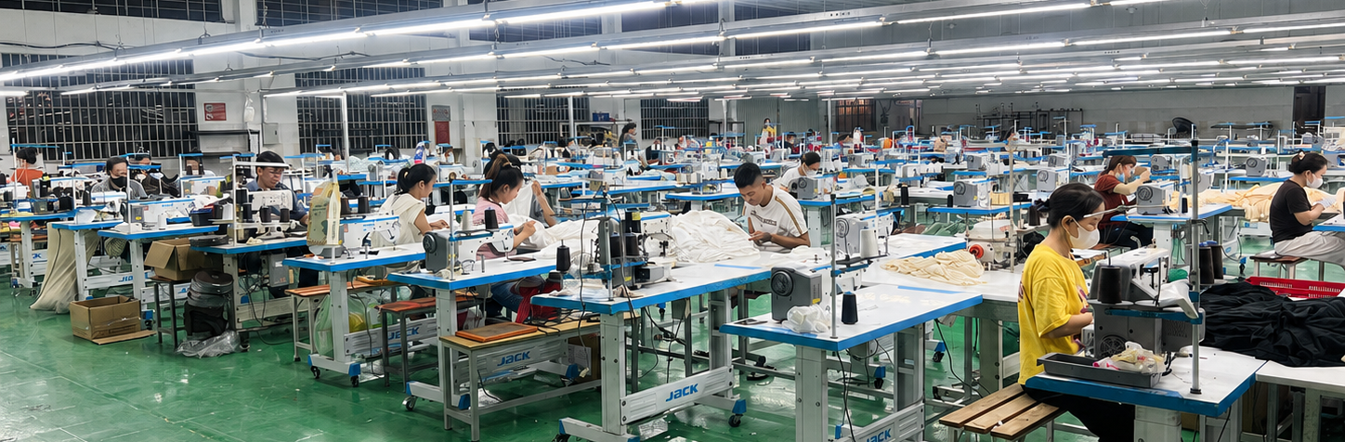
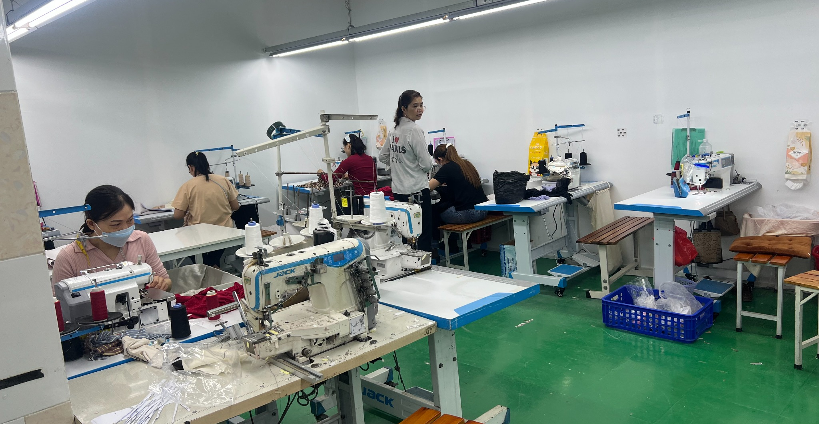
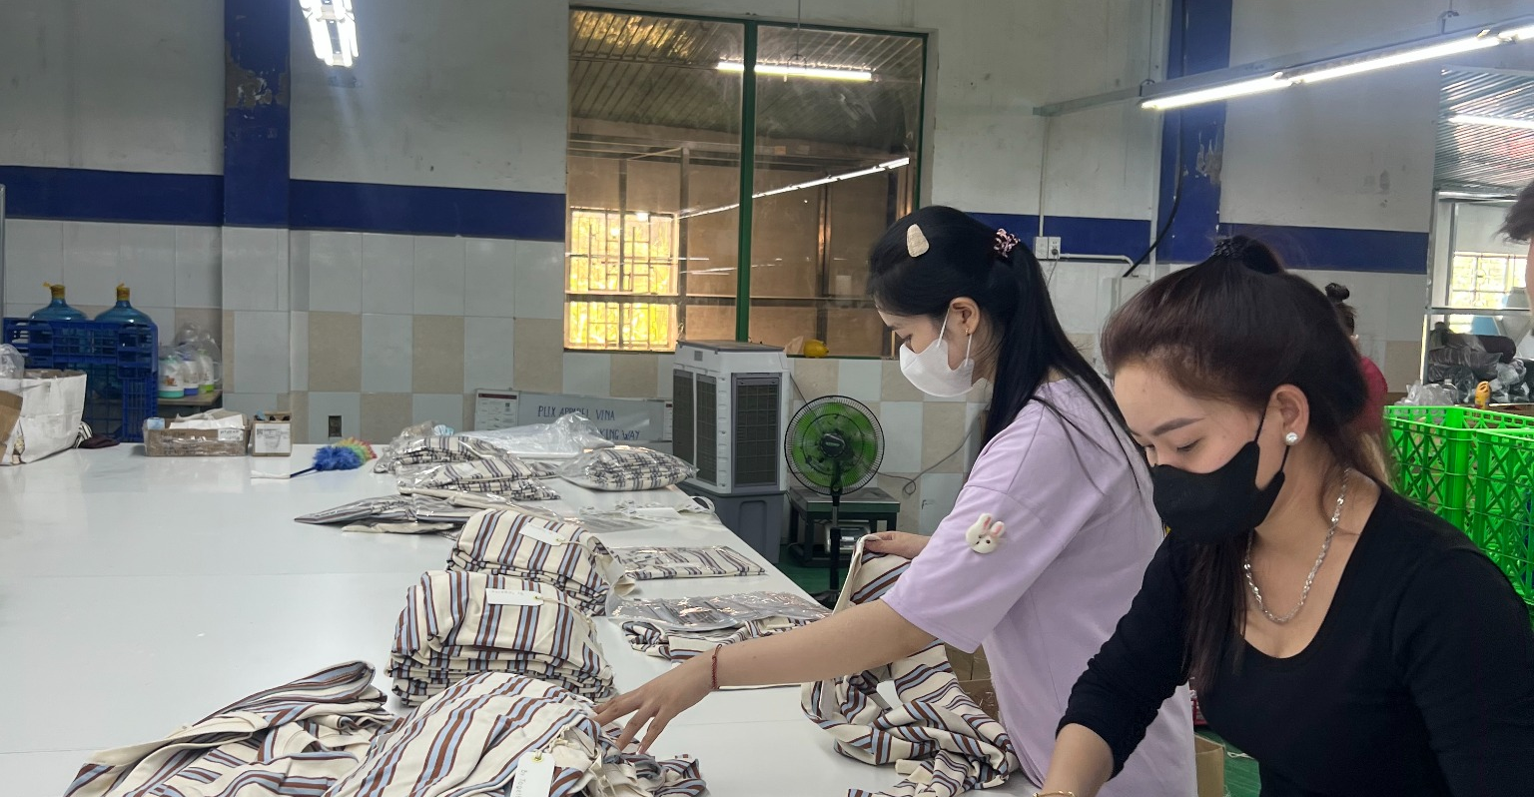
PRODUCTION
Six core lines with flexible production support
DAILY OUTPUT STANDARD
500 PCS
WOVEN / LINE / DAY
1,000 PCS
PLIX APPAREL VINA • SEWING FLOOR
KNIT / LINE / DAY
6-LINE PLANNING RANGE
3,000–6,000 PCS / DAY
Planning basis varies by product mix, style complexity, SAM, and operating efficiency.
SPECIAL MACHINE & SAMPLE SUPPORT
FINISHING & PACKING
PLIX APPAREL VINA • FACTORY PROFILE 2026
04
Notes:
[Sources]
- User-provided 2026_PrixApparel_version02.pptx
- User-provided PLIX VINA PROFILE 2026.pptx
- Current Plix Apparel Vina factory photographs supplied directly by the user; main sewing-floor photo conservatively retouched to remove a camera obstruction; daily output standards supplied directly by the user

Slide 5
MACHINERY INVENTORY
153 machines support six-line production
Current installed equipment reported across sewing, cutting, finishing, and material-control functions.
NO
NAME OF MACHINE
QTY
01
Single-needle sewing machine
84
02
Overlock sewing machine
36
03
Coverstitch machine
18
04
12-needle coverstitch machine
1
05
Bartack machine
2
06
Buttonhole machine
2
07
Button attaching machine
2
08
Fusing machine
1
09
Handheld fabric cutting machine
3
10
Binding cutting machine
1
11
Bag sealing machine
1
12
Fabric shrinkage machine
1
13
Fabric inspection machine
1
PLIX APPAREL VINA • FACTORY PROFILE 2026
05
Notes:
[Sources]
- User-provided 2026_PrixApparel_version02.pptx
- User-provided PLIX VINA PROFILE 2026.pptx
- Machinery inventory supplied directly by the user; 13 machine categories and 153 total units

Slide 6
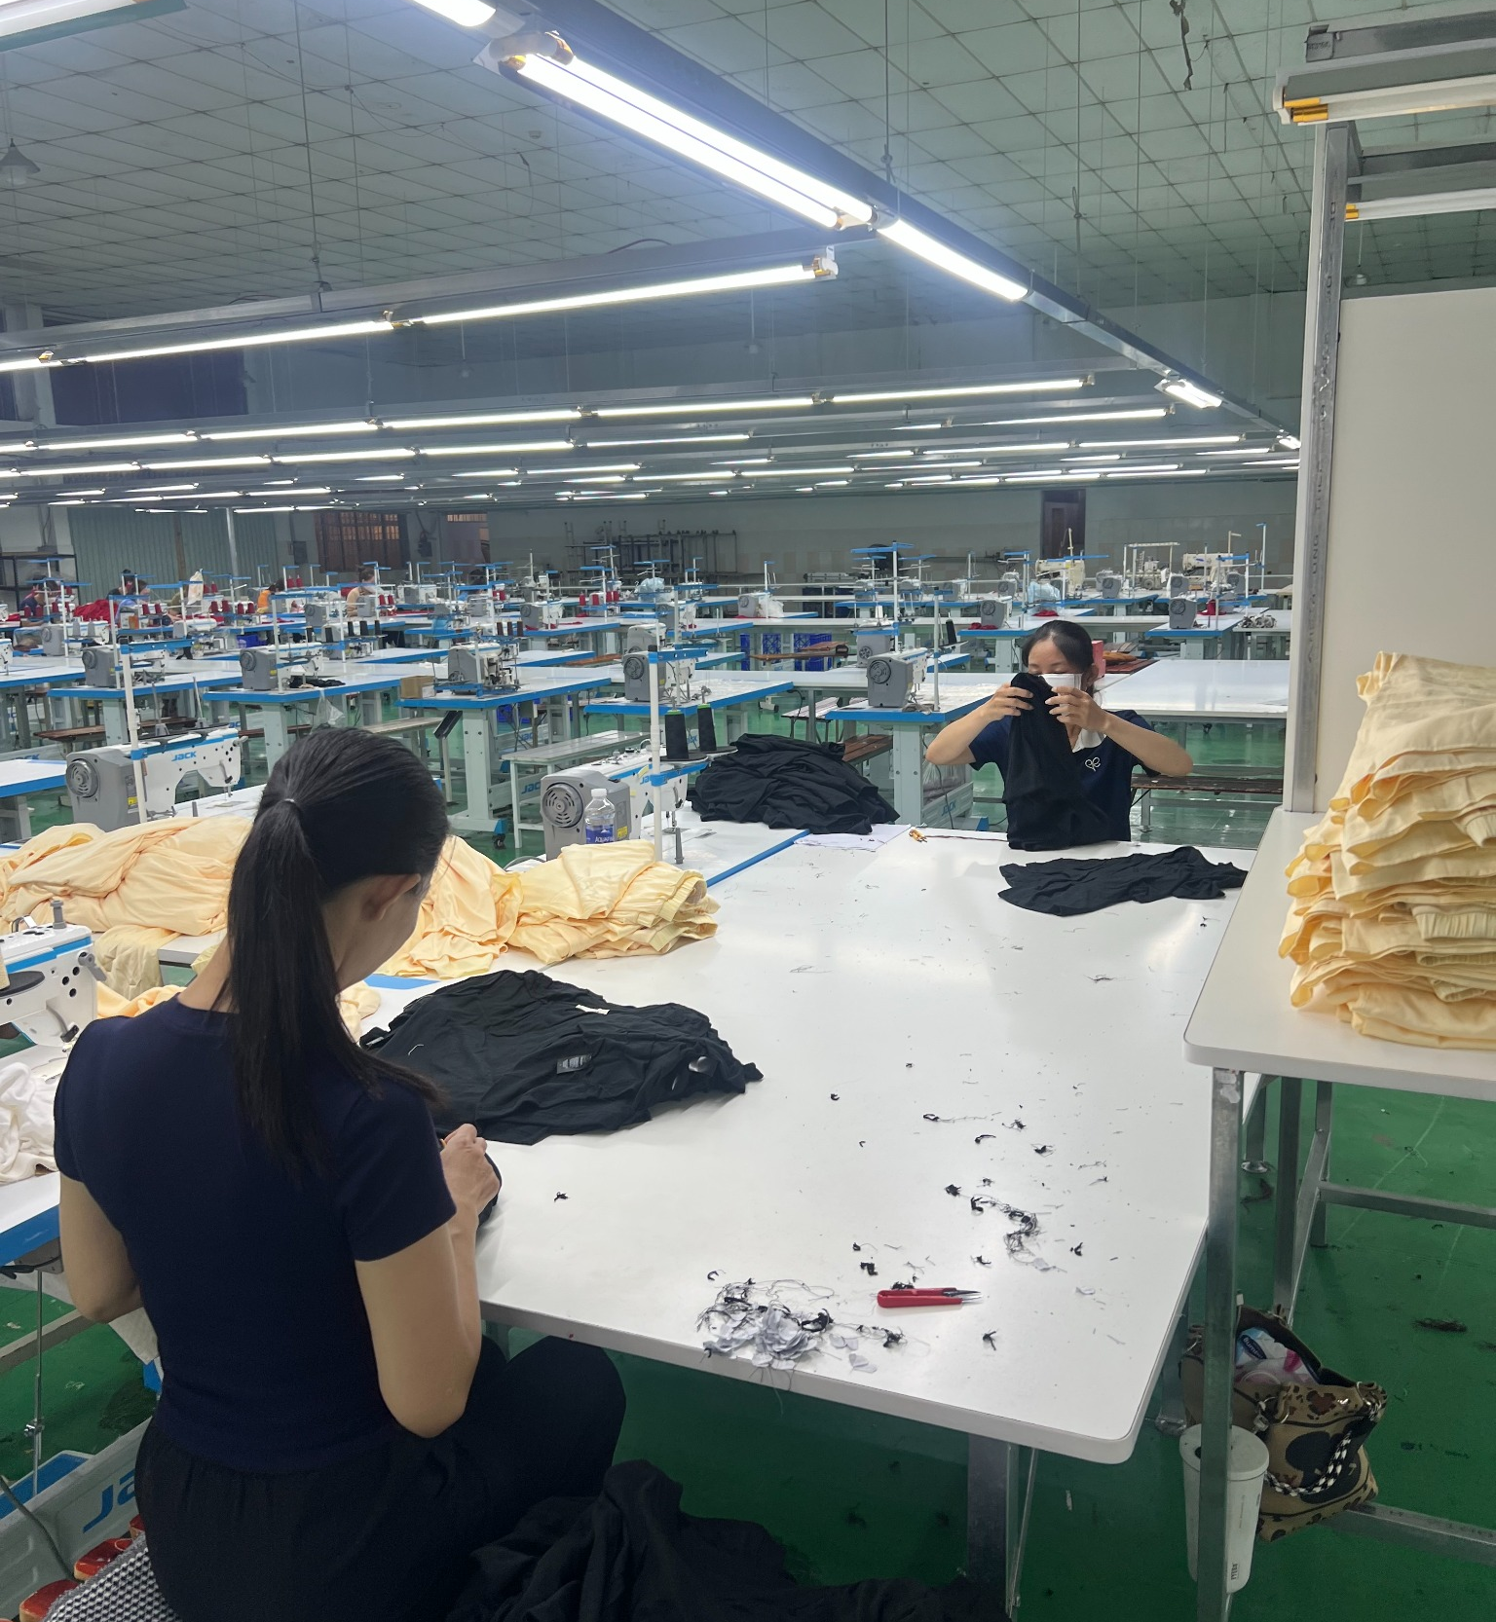
QUALITY & OWNERSHIP
Quality is controlled at every stage
Independent checkpoints create visibility before defects move downstream.
01
Fabric inspection
02
Cutting QC
Incoming material review and fabric quality control.
Control spreading, cutting accuracy, and bundle integrity.
03
Inline QC
04
End-line QC
Monitor workmanship and measurements during sewing.
Check completed pieces before finishing and packing.
05
Final QA
06
Packing control
Review appearance, workmanship, measurement, and audit readiness.
Verify assortment, labels, packing method, and cargo release.
INLINE INSPECTION & FINISHING
CLEAR OWNERSHIP • Production • Quality Assurance • Administration • Warehouse
PLIX APPAREL VINA • FACTORY PROFILE 2026
06
Notes:
[Sources]
- User-provided 2026_PrixApparel_version02.pptx
- User-provided PLIX VINA PROFILE 2026.pptx
- Quality checkpoints and organization responsibilities consolidated from the user-provided Plix Apparel Vina profile; inline inspection photograph supplied directly by the user

Slide 7
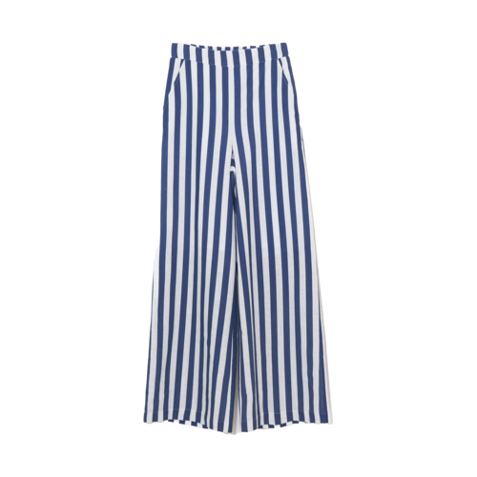
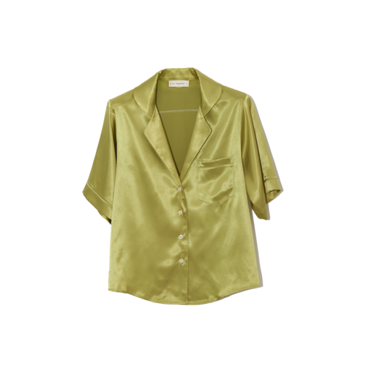

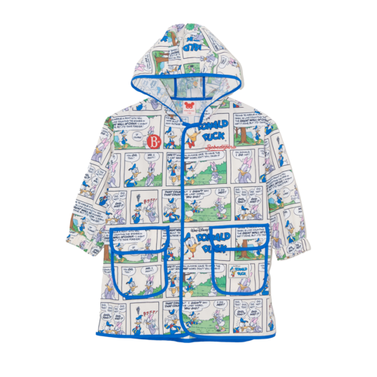
PRODUCT & MARKET EXPERIENCE
Balanced categories, proven buyer experience
SELECTED PRODUCT EXPERIENCE
PLIX APPAREL GROUP PROFILE • 2025
BUSINESS CATEGORY
55%
WOVEN
45%
KNIT
CLIENT BASE
88%
U.S. MARKET
12%
KOREA
SELECTED CLIENT EXPERIENCE
TJ Maxx • The Buckle • Bloomingdale’s • By Together
A. Ren • BTR • PUMA Kids • Bebebedepino
PLIX APPAREL VINA • FACTORY PROFILE 2026
07
Notes:
[Sources]
- User-provided 2026_PrixApparel_version02.pptx
- User-provided PLIX VINA PROFILE 2026.pptx
- Product cutouts and 2025 commercial mix consolidated from the user-provided Plix Apparel profiles

Slide 8
CONTACT
NEXT PROGRAM
Wendy
Ready to support
the next stage of growth.
Factory Manager
PHONE
+84 938 730 770
Share your product category, style mix, order volume, and target calendar so the team can align development and line capacity.
EMAIL
plix@plix-apparel.com
LOCATION
Ho Chi Minh City, Vietnam
FACTORY PROFILE • 03 SEP 2026
08
Notes:
[Sources]
- User-provided 2026_PrixApparel_version02.pptx
- User-provided PLIX VINA PROFILE 2026.pptx
- The former street address was intentionally omitted because the factory has relocated

